Slide 1
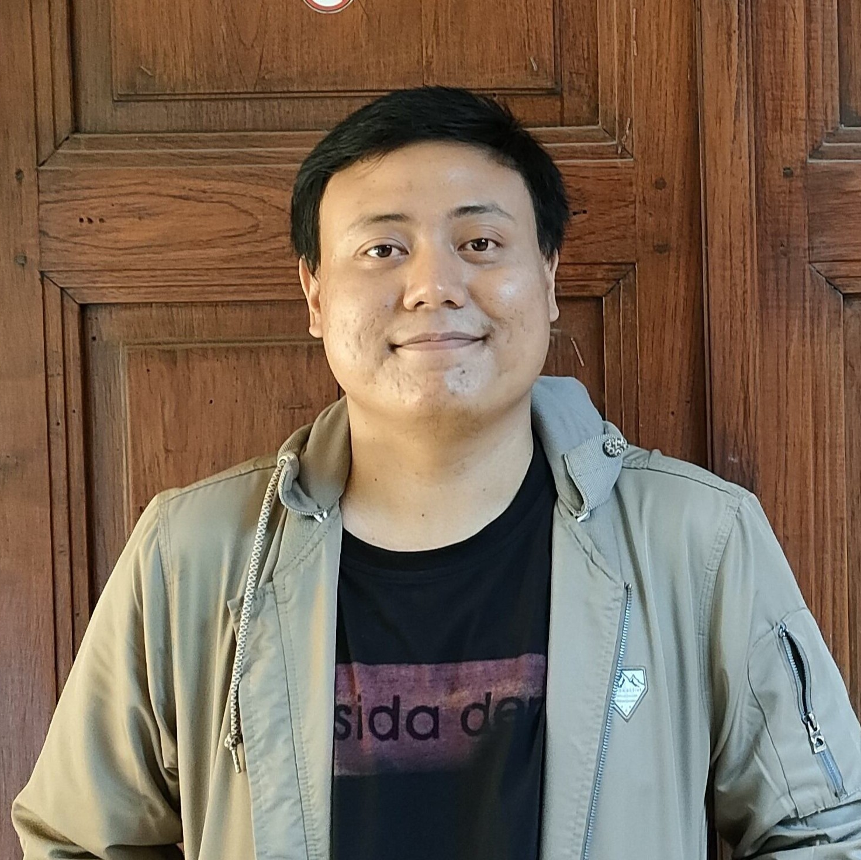
Improving Employee Retention by Predicting Employee Attrition Using Machine Learning
Created by:
Muhammad Cikal Merdeka
Email : mcikalmerdeka@gmail.com
LinkedIn : linkedin.com/in/mcikalmerdeka
Github : github.com/mcikalmerdeka
Dedicated entry-level data scientist with analytical and experimental background of Physics. My graduation 2023, a pivotal year marked by significant advancements in artificial intelligence with the introduction of GPT-4 and other generative AI models, has fueled my curiosity and excitement to delve into the field of data. I have comprehensive grasp of data science methodology from business understanding to modelling process with proficiency in Python, SQL, Tableau, Power BI, Looker Studio and other tools related to data analytics workflow from several coursework and bootcamps.

Slide 2
Annual Report on Employee Number Changes
Masukkan grafik visualisasi pada tugas ini, kemudian tuliskan pula hasil analisismu, insight apa saja yang kamu dapatkan.

